Slide 1
ENSE 496AB
Milestone 4
Health-Esteem
November 15th, 2018
Quinn Bast | Jennifer Herasymuik
Shawn Clake | Chengyu Lou
Tristan Heisler | Wilson Nie
Notes:
Shawn

Slide 2
Team Introductions
Team Members:
Jennifer Herasymuik
Shawn Clake
Tristan Heisler
Quinn Bast
Wilson Nie
Chengyu Lou
Team Name:
Health-Esteem
Assigned Project:
Braintrust
Notes:
Shawn

Slide 3
USM Review and Rationalization
Envisioned Features
Idea tracking, categories and rating. User roles and more flexible account management. Leaderboards, textual statistics and rewards for collaboration.
Changes in the USM
Tasks associated with reward management and redemption were moved to MVP 4.
Rationalization
This release provides users with additional idea interaction (tracking, rating and filtering) as well as the ability to update their account information. Access to different pieces of the application can now be restricted to certain users.
Notes:
Quinn

Slide 4
Timeline
Discussed MVP 3 requirements with Janice
Group Programming Session
Group Programming Session
Practiced Presentation
Oct 25
Nov 2
Nov 13
Oct 25
Oct 26
Nov 2
Nov 15
Distributed MVP 3 Tasks
Inquired about rewards system
Made PowerPoint
Notes:
Wilson

Slide 5
Contributions
Team Member Main Priorities
Jenn - User roles and backend support for rating/tracking ideas
Oscar - User manual and unit testing
Quinn - Consent form, questionnaires, idea filtering, statistics and leaderboards
Shawn - Idea page styling and content overhaul, graphing investigation, QoL changes
Tristan - Ability to rate and track ideas, idea page styling
Wilson - Profile overview, account modification and profile picture uploading
There was overlap of these responsibilities among other group members.
ie. Pair programming sessions when working on Leaderboards and Statistics pages
Notes:
Wilson

Slide 6
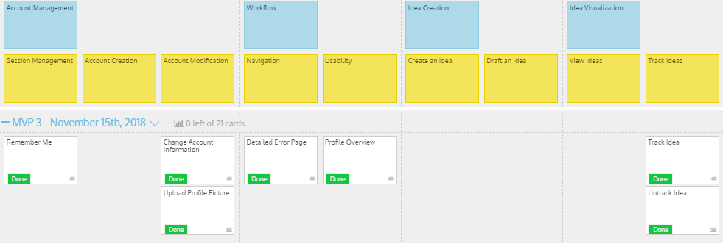
MVP 3/Milestone 4 USM
Notes:
Tristan

Slide 7
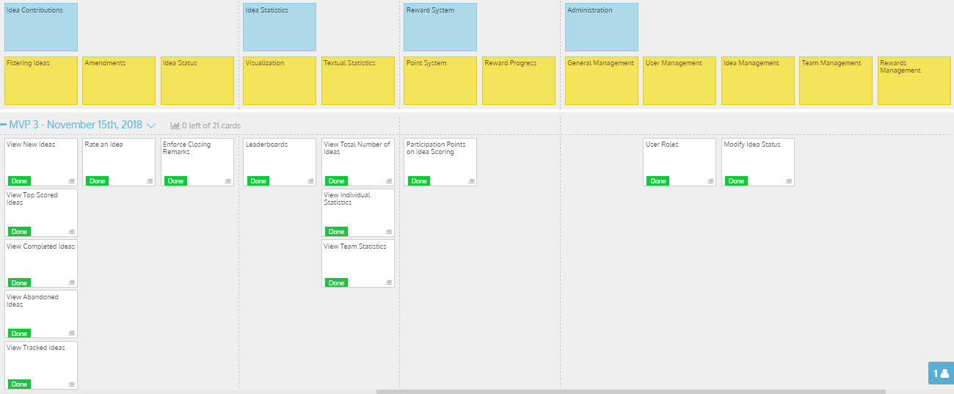
MVP 3/Milestone 4 USM (cont.)
Notes:
Tristan

Slide 8
Milestone 4
Demo
Health-Esteem
Notes:
Tristan

Slide 9
Discussion
Success
With the exception of tasks moved due a current lack of information, all tasks were successfully achieved for this milestone.
The consent form and pre-task questionnaire have been completed. The task and post-task questionnaire will be completed in time for the on-site visit.
Barriers
Uncertainty concerning the desired reward system.
Browser compatibility.
Notes:
Oscar

Slide 10
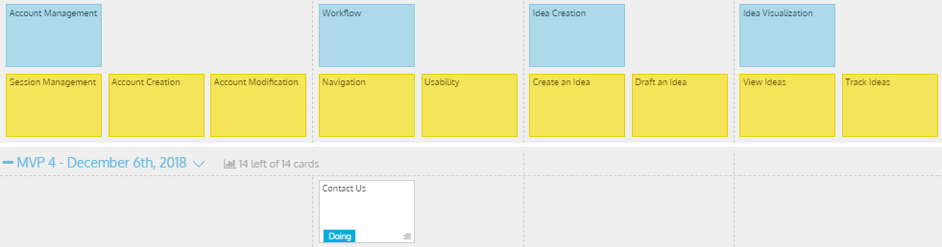
MVP 3/Milestone 4 USM
Notes:
Jenn

Slide 11
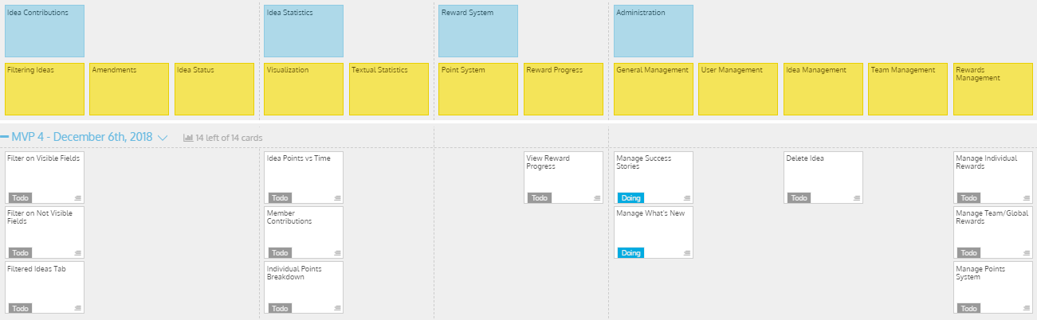
MVP 3/Milestone 4 USM (cont.)
Notes:
Jenn

Slide 12
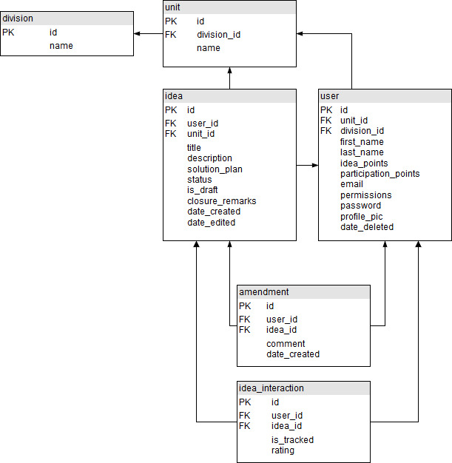
Database Design - Current UML
Notes:
Jenn - It’s the same. Talk about rewards, what’s new and success stories.

Slide 13
Documentation
Consent Form: Completed.
Pre-Task Questionnaire: Completed.
Task Questionnaire: In progress.
Post-Task Questionnaire: In progress.
User Manual: In progress.
The task and post-task questionnaire will be based on the documents developed by Braintrust.
Notes:
Quinn - tab to the consent form and pre-task questionnaire and go over them.

Slide 14
Group Reflection
How do you feel about this milestone? What do you like about it? What did you dislike?
Like: Seeing the application come together is rewarding
Dislike: The week off created some disorganization among group members
Dislike: The vague response concerning rewards management. We would prefer not to develop a feature that the user does not require or value.
What did you learn about yourself as you collaborated and worked through this milestone?
Multiple brains and setting egos aside allowed us to solve roadblocks quickly and improve upon existing features.
Notes:
Shawn

Slide 15
Group Reflection (cont.)
How will you use what you have learned going forward?
Going forward we will critically analyze the design to improve the application now that the core functionality has been completed.
What “stuff & things” related to this milestone would you want help with?
How should the rewards system be implemented? Is the system tracking rewards, or is it sending an email to a manager?
Feedback on this milestone.
Notes:
Shawn

Slide 16
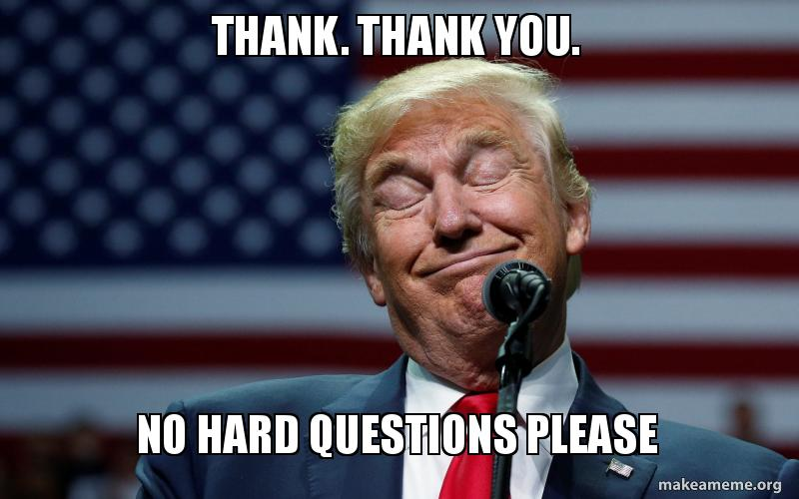
Questions?
Notes:
Shawn

